Slide 1
Unit - III
Subprograms, Blocks, Implementing Subprograms and Abstract Data Types

Slide 2
.
Subprograms
Subprograms are the fundamental building blocks of programs and are therefore among the most important concepts in programming language design.
Two fundamental abstraction facilities can be included in a programming language:
Process abstraction & Data abstraction.
Abstraction
A less detailed representation of an object or concept in nature.
An abstraction is a view or representation of an entity that includes only the most significant attributes.

Slide 3
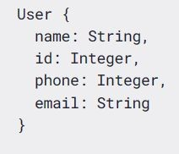
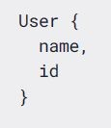
.
Two examples of data models which are more and less detailed
In the early history of high level programming languages, only process abstraction was included.
Process abstraction, in the form of subprograms, has been a central concept in all programming languages.

Slide 4
.
In the 1980s, however, many people began to believe that data abstraction was equally important.
Subprograms increases the readability of a program by emphasizing its logical structure while hiding the low-level details.
The methods of object-oriented languages are closely related to the sub programs.
The primary way methods differ from subprograms is the way they are called and their associations with classes and objects.
In a modern programming language, such a collection of statements is written as a subprogram.
This reuse results in several different kinds of savings,
primarily memory space and coding time.

Slide 5
.
Such reuse is also an abstraction, for the details of the subprograms computation are replaced in a program by a statement that calls the subprogram.
General Subprogram Characteristics
Each subprogram has a single entry point
The calling program unit is suspended during the execution of the called subprogram, which implies that there is only one subprogram in execution at any given time.
Control always returns to the caller when the subprogram execution terminates.
Definitions:
A subprogram definition describes the interface to and the actions of the sub program abstraction

Slide 6
.
subprogram call: A subprogram call is the explicit request that a specific subprogram be executed.
subprogram header :A subprogram header, which is the first part of the definition, serves several purposes. It specifies that the following syntactic unit is a subprogram definition of some particular kind.
Consider the following header examples:
def adder parameters):
This is the header of a Python subprogram named adder.
In C, the header of a function named adder might be as follows:
void adder (parameters)
The reserved word void in this header indicates that the subprogram does not return a value.

Slide 7
.
parameter profile: The parameter profile of a subprogram contains the number, order, and types of its formal parameters.
Protocol: The protocol of a subprogram is its parameter profile plus, if it is a function, its return type. In languages in which subprograms have types, those types are defined by the subprogram’s protocol.
Active subprogram : A subprogram is said to be active if, after having been called, it has begun execution but has not yet completed that execution.
Body of subprogram: Body of subprogram defines its action.
In C based languages body of sub program is delimited by braces.
In Ruby, an end statement terminates body of subprogram.

Slide 8
.
    Parameters profile: the parameter profile of sub program contains the number , order and type of its formal parameters
    Subprogram declaration: subprogram declaration provide subprogram protocol but do not include their bodies
Formal parameters: The parameters in the subprogram header are called formal parameters.
Actual parameters: Subprogram call statements must include the name of the subprogram and a list of parameters to be bound to the formal parameters of the subprogram. These parameters are called actual parameters.
Positional parameters: The binding of actual parameters to formal parameters is done by position is called positional parameter.

Slide 9
.
Keyword parameters: When parameter lists are long, however, it is easy for a programmer to make mistakes in the order of actual parameters in the list. One solution to this problem is to provide keyword parameters, in which the name of the formal parameter to which an actual parameter is to be bound is specified with the actual parameter in a call.
Python functions can be called using this technique, as in
sumer(length = my_length,
list = my_array,
sum = my_sum)
where the definition of sumer has the formal parameters length, list, and sum.
The disadvantage to keyword parameters is that the user of the subprogram must know the names of formal parameters.

Slide 10
.
Design issues for sub programs
If subprograms can be passed as parameters and subprograms can be nested, what is the referencing environment of a passed subprogram?
Can subprograms be overloaded?
Can subprograms be generic?
If the language allows nested subprograms, are closures supported?
Are local variables statically or dynamically allocated?
Can subprogram definitions appear in other subprogram definitions? What parameter-passing method or methods are used?
Are the types of the actual parameters checked against the types of the formal parameters?

Slide 11
.
Subprograms can be designed by using
Parameter-Passing methods,
Local referencing environments,
Overloaded subprograms
Generic subprograms
overloaded subprogram
An overloaded subprogram is a subprogram that has the same name as another subprogram in the same referencing environment.
Every version of an overloaded subprogram must have a unique protocol

Slide 12
.
Local Referencing Environments
Local referencing environment of sub program means scope of component whether it is local or global or any other sub program , where component can be accessed.
Local variable
Nested sub program
Local Variables: Variables that are defined inside subprograms are called local variables, because their scope is usually the body of the subprogram in which they are defined.
stack-dynamic local variables: At run time memory will allocated to that variable.
Advantage
flexibility
Support recursion
Shared memory

Slide 13
.
Disadvantages
Every time allocation and deallocation
Indirect access
Static local variable : at compile time memory is allocated.
Eg. Int add(int a,int b)
{
int sum;
static int b;
sum=a+b;
return sum;
}
Advantages:
No memory wastage for allocation and deallocation
Direct access

Slide 14
.
Disadvantages:
Do not support recursion.
For example, in the following C (or C++) function, the variable sum is static and count is stack dynamic.
int adder(int list[], int listlen)
{
static int sum = 0;
int count;
for (count = 0; count < listlen; count ++)
sum += list [count];
return sum;
}

Slide 15
.
External or global variable : A global variable are variable define out side the sub program or method.
It has global scope means it holds through out the program. so it can be accessed through out the program by function.
    Nested Subprograms
    void factorial()
    {
    void product( )
    {
    ------------
    }
    }

Slide 16
.
Some language like C,C++ does not supported nested subprograms but javascript support nested subprograms.
In above example for product() subprogram can be called only when we call factorial () subprogram.
So, product ()sub program has local referencing environment of factorial() sub program.
  Parameter-Passing Methods
Parameter-passing methods are the ways in which parameters are transmitted to and/or from called subprograms.
Parameter passing depends on model of subprogram
There two model for parameter passing
    Semantics Models of Parameter Passing
    Implementation Models of Parameter Passing

Slide 17
.
    Semantics Models of Parameter Passing: Formal parameters are characterized by one of three distinct semantics models:
(1) They can receive data from the corresponding actual parameter;
(2) they can transmit data to the actual parameter; or (3) they can do both. These models are called in mode, out mode, and inout mode, respectively.
There are two conceptual models of how data transfers take place in parameter transmission: Either an actual value is copied (to the caller, to the called, or both ways) or an access path is transmitted. Most commonly, the access path is a simple pointer or reference

Slide 18
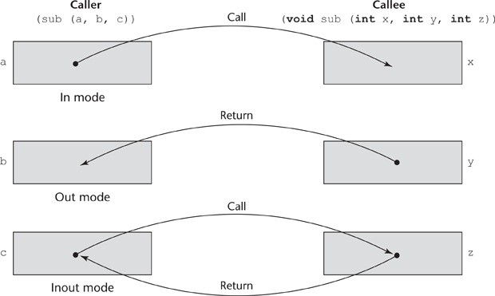
.
The three semantics models of parameter passing when physical moves are used

Slide 19
.
    Implementation Models of Parameter Passing
A variety of models have been developed by language designers to guide the implementation of the three basic parameter transmission modes.
      Pass-by-Value
      Pass-by-Result
      Pass-by-Value-Result
      Pass-by-Reference
      Pass-by-Name
Pass-by-Value: When a parameter is passed by value, the value of the actual parameter is used to initialize the corresponding formal parameter, which then acts as a local variable in the subprogram, thus implementing in-mode semantics.

Slide 20
.
Pass-by-value is normally implemented by copy, because accesses often are more efficient with this approach. It could be implemented by transmitting an access path to the value of the actual parameter in the caller, but that would require that the value be in a write-protected cell (one that can only be read).
The advantage of pass-by-value is that for scalars it is fast, in both linkage cost and access time.
The main disadvantage of the pass-by-value method if copies are used is that additional storage is required for the formal parameter, either in the called subprogram or in some area outside both the caller and the called subprogram

Slide 21
.
      Pass-by-Result: Pass-by-result is an implementation model for out-mode parameters
      When a parameter is passed by result, no value is transmitted to the subprogram.
      One problem with the pass-by-result model is that there can be an actual parameter collision, such as the one created with the call
Eg: The out specifier must also be specified on the corresponding actual parameter.
void Fixer(out int x, out int y)
{
x = 17;
y = 35;
}
. . .
f.Fixer(out a, out a);

Slide 22
.
Another problem that can occur with pass-by-result is that the implementor may be able to choose between two different times to evaluate the addresses of the actual parameters: at the time of the call or at the time of the return. For example, consider the following C# method and following code:
void DoIt(out int x, int index)
{
x = 17;
index = 42;
}
. . .
sub = 21;
f.DoIt(list[sub], sub);

Slide 23
.
      Pass-by-Value-Result: Pass-by-value-result is an implementation model for inout-mode parameters in which actual values are copied.
      Pass-by-value-result is sometimes called pass-by-copy, because the actual parameter is copied to the formal parameter at subprogram entry and then copied back at subprogram termination.
      Pass-by-Reference: Pass-by-reference is a second implementation model for inout-mode parameters is passed by addresses or reference.
      The advantage of pass-by-reference is that the passing process itself is efficient, in terms of both time and space.
problem of pass-by-reference is that aliases can be created.

Slide 24
.
Consider a C++ function that has two parameters that are to be passed by reference, as in
void fun(int &first, int &second)
If the call to fun happens to pass the same variable twice, as in
fun(total, total)
then first and second in fun will be aliases.
      Pass-by-Name: Pass-by-name is an inout-mode parameter transmission mode When parameters are passed by name, the actual parameter is substituted by corresponding formal parameters.
      ALGOL is supported by pass by name.

Slide 25
.
    Examples of Parameter Passing
Consider the following C function:
void swap1(int a, int b) {
int temp = a;
a = b;
b = temp;
}
Suppose this function is called with
swap1(c, d);
Recall that C uses pass-by-value. The actions of swap1 can be described by the following pseudocode:

Slide 26
.
a = c - Move first parameter value in
b = d - Move second parameter value in temp = a
a = b
b = temp
Although a ends up with d’s value and b ends up with c’s value, the values of
c and d are unchanged because nothing is transmitted back to the caller.
We can modify the C swap function to deal with pointer parameters to achieve the effect of pass-by-reference:
void swap2(int *a, int *b) {
int temp = *a;
*a = *b;
*b = temp;
}

Slide 27
.
  Parameters That Are Subprograms
In programming, a number of situations occur that are most conveniently handled if subprogram names can be sent as parameters to other subprograms
One common example of these occurs when a subprogram must sample some mathematical function.
First, there is the matter of type checking the parameters of the activations of the subprogram that was passed as a parameter
The second complication with parameters that are subprograms appears only with languages that allow nested subprograms.
The issue is what referencing environment for executing the passed subprogram should be used.

Slide 28
.
There are three choices:
The environment of the call statement that enacts the passed subprogram (shallow binding)
The environment of the definition of the passed subprogram (deep binding)
The environment of the call statement that passed the subprogram as an actual parameter (ad hoc binding)
The following example program, written with the syntax of JavaScript, illustrates these choices:
function sub1() {
var x;
function sub2() {
alert(x); // Creates a dialog box with the value of x
};

Slide 29
.
function sub3() {
var x; x = 3;
sub4(sub2);
};
function sub4(subx) {
var x; x = 4;
subx();
}; x = 1;
sub3();
};

Slide 30
.
Consider the execution of sub2 when it is called in sub4. For shallow binding, the referencing environment of that execution is that of sub4, so the reference to x in sub2 is bound to the local x in sub4, and the output of the program is 4. For deep binding, the referencing environment of sub2’s execution is that of sub1, so the reference to x in sub2 is bound to the local x in sub1, and the output is 1. For ad hoc binding, the binding is to the local x in sub3, and the output is 3.
Ad hoc binding has never been used because, one might surmise, the environment in which the procedure appears as a parameter has no natural connection to the passed subprogram.

Slide 31
.
  Calling Subprograms Indirectly
These most often occur when the specific subprogram to be called is not known until run time.(eg: event handling & GUIs)
In C, C++ ,such calls are made through the function pointers
In C#, the power and flexibility of method pointers is increased by making them objects. These are called delegates, because instead of calling a method, a program delegates that action to a delegate.
The syntax of a declaration of a delegate is the same as that of a method declaration, except that the reserved word delegate is inserted just before the return type. For example, we could have the following:
public delegate int Change(int x);
This delegate can be instantiated with any method that takes an int as a parameter and returns an int.

Slide 32
.
Overloaded subprogram:
An overloaded subprogram is one that has the same name as another subprogram in the same referencing environment.
Every version of overloaded subprogram has unique protocol that is it must be different from other in number , order or type of its parameter return type if is function.
In ADA return type of overloaded function can be used to disambiguate calls(thus two overloaded function can have same parameter).
ADA , Java , C++ & C# allow user to write multiple versions of subprograms with the same.
The meaning of call to overloaded subprograms to determined by actual parameter.
Many classes in C++ , Java & C# have overloaded constructor.

Slide 33
.
Eg : C++ code
void show
{
Count<<a;
}
void show(int a, int b)
{
Count<<a<<b;
}
int main(){
int a=10,b=20;
Show(a);
Show(a,b);
return 0;}

Slide 34
.
Generic subprogram:
Software reuse can be an important contributor to software productivity.
To increase the reusability of software is to lessen the need to create different subprograms that implement the same algorithm on different types of data.
For example, a programmer should not need to write four different sort subprograms to sort four arrays that differ only in element type.
Polymorphism : subprogram takes parameter different types of different activations.
Overloaded subprogram provide a particular kind polymorphisms called ad hoc polymorphism.
Languages that are support object oriented programming usually support sub type polymorphism.

Slide 35
.
Subtype polymorphism means that a variable of type T can be access any object of type T or any type derived from T.
Parametric polymorphism is provided by sub program that takes generic parameter that are used in type expression that describe types of parameter of sub program.
Parametrically polymorphic sub program is called generic sub program.
ADA, java5.0 +,C# 2005 +& F# provide a compile time parametric polymorphism.
    Generic Functions in C++: version of generic subprogram created implicity when subprogram named in a call with the an operator.
    Generic subprogram preceded by template clause that list the generic variables, which can be type name or class name

Slide 36
.
As an example of a template function, consider the following:
template <class Type>
Type max(Type first, Type second) {
return first > second ? first : second;
}
where Type is the parameter that specifies the type of data on which the function will operate. This template function can be instantiated for any type for which the operator > is defined.
The following is a C++ generic sort subprogram:

Slide 37
.
template <class Type>
void generic_sort(Type list[], int len)
{
int top, bottom; Type temp;
for (top = 0; top < len - 2; top++)
for (bottom = top + 1; bottom < len - 1; bottom++)
if (list[top] > list[bottom])
{
temp = list[top];
list[top] = list[bottom]; list[bottom] = temp;
} //** end of if (list[top] . . .
} //** end of generic_sort

Slide 38
.
    Generic Methods in Java 5.0:Java’s generic methods differ from the generic subprograms of C++ in several important ways
    Generic parameters must be classes
    Java generic methods can be instantiated any number of times, only one copy of the code is built.
in Java, restrictions can be specified on the range of classes that can be passed to the generic method as generic parameters. Such restrictions are called bounds.
    Java 5.0 supports wildcard types
public static <T> T doIt(T[] list) {
. . .
}
This defines a method named doIt that takes an array of elements of a generic type. The name of the generic type is T and it must be an array.

Slide 39
.
Following is an example call to doIt:
public static <T extends Comparable> T doIt(T[] list) {
. . .
}
For example, Collection<?> is a wildcard type for collection classes.
void printCollection(Collection<?> c)
{
for (Object e: c)
{
System.out.println(e);
}
}

Slide 40
.
    Generic Methods in C# 2005 : The generic methods of C# 2005 are similar in capability to those of Java 5.0.
    One unique feature of C# 2005 generic methods is that the actual type parameters in a call can be omitted if the compiler can infer the unspecified type
    C# does not support wild cards.
For example, consider the following skeletal class definition:
class MyClass {
public static T DoIt<T>(T p1) {
. . .
}
}
The method DoIt can be called without specifying the generic parameter if the compiler can infer the generic type from the actual parameter in the call.

Slide 41
.
Generic Functions in F#: F# infers a generic type for the parameters and the return value.
This is called automatic generalization.
Functions can be defined to have generic parameters, as in the following example:
let printPair (x: 'a) (y: 'a) =
printfn "%A %A" x y;;
The generic type could also be specified explicitly in angle brackets, as in the following:
let printPair2<'T> x y = printfn "%A %A" x y;;
This function must be called with a type

Slide 42
.
  Design Issues for Functions
The following design issues are specific to functions:
Are side effects allowed?
What types of values can be returned?
How many values can be returned?
  Functional Side Effects : Ada functions can have only in-mode formal parameters. This requirement effectively prevents a function from causing side effects through its parameters or through aliasing of parameters and globals.
  most other imperative languages, however, functions can have either pass-by-value or pass-by- reference parameters, thus allowing functions that cause side effects and aliasing.
  Pure functional languages, such as Haskell and Ruby, do not have variables, so their functions cannot have side effects.

Slide 43
.
    Types of Returned Values:Most imperative programming languages restrict the types that can be returned by their functions
    C allows any type to be returned by its functions except arrays and functions. Both of these can be handled by pointer type return values.
. C++ is like C but also allows user-defined types, or classes, to be returned from its functions.
Ada, Pamong current imperative languages whose functions (and/or methods) can return values of any type. In the case of Ada, however, because functions are not types in Ada, they cannot be returned from functions. Of course, pointers to functions can be returned by functions.ython, and Ruby are the only languages

Slide 44
.
    Number of Returned Values:In most languages, only a single value can be returned from a function. However, that is not always the case.
    Ruby allows the return of more than one value from a method. If a return statement in a Ruby method is not followed by an expression, nil is returned.
    If followed by one expression, the value of the expression is returned. If followed by more than one expression, an array of the values of all of the expressions is returned.
    In ML, F#, and Python, and some other languages that include tuples, multiple values can be returned by placing them in a tuple.

Slide 45
.
  User-Defined Overloaded Operators
Operators can be overloaded by the user in Ada, C++, Python, and Ruby.
Eg:
def add (self, second):
return Complex(self.real + second.real, self.imag + second.imag)
  Closures:
  A closure is a subprogram and the referencing environment where it was defined. The referencing environment is needed if the subprogram can be called from any arbitrary place in the program.
  static-scoped programming language does not allow nested subprograms, closures are not useful.

Slide 46
.
Nearly all functional programming languages, most scripting languages, and at least one primarily imperative language, C#, support closures.
static-scoped, allow nested subprograms , and allow
subprograms to be passed as parameters.
Eg;
function makeAdder(x) {
return function(y) {return x + y;}
}
. . .
var add10 = makeAdder(10);
var add5 = makeAdder(5);
document.write("Add 10 to 20: " + add10(20) + "<br />");
document.write("Add 5 to 20: " + add5(20) + "<br />");
The output of this code, assuming it was embedded in an HTML document and displayed with a browser, is as follows:
Add 10 to 20: 30
Add 5 to 20: 25

Slide 47
.
  Coroutines
A coroutine is a special kind of subprogram.
This also called as symmetric control.
They also have the means to maintain their status between activations.
Coroutines can have multiple entry points, which are controlled by the coroutines themselves.
This means that coroutines must be history sensitive and thus have static local variables
Secondary executions of a coroutine often begin at points other than its beginning. Because of this, the invocation of a coroutine is called a resume rather than a call.
For example, consider the following skeletal coroutine:

Slide 48
.
sub co1(){
. . .
resume co2();
. . .
resume co3();
. . .
}
The first time co1 is resumed, its execution begins at the first statement and executes down to and including the resume of co2, which transfers control to co2.
The next time co1 is resumed, its execution begins at the first statement after its call to co2. When co1 is resumed the third time, its execution begins at the first statement after the resume of co3.

Slide 49
.
One of the usual characteristics of subprograms is maintained in coroutines: Only one coroutine is actually in execution at a given time.
The first resume f a coroutine is to its beginning but subsequent call enter at the point just after last executed statement in the coroutine.
Sort of interleaved execution sequence is related to the way multiprogramming operating systems work.
Although there may be only one processor, all of the executing programs in such a system appear to run concurrently while sharing the processor. In the case of coroutines, this is sometimes called quasi-concurrency.
Typically, coroutines are created in an application by a program unit called the master unit, which is not a coroutine.

Slide 50
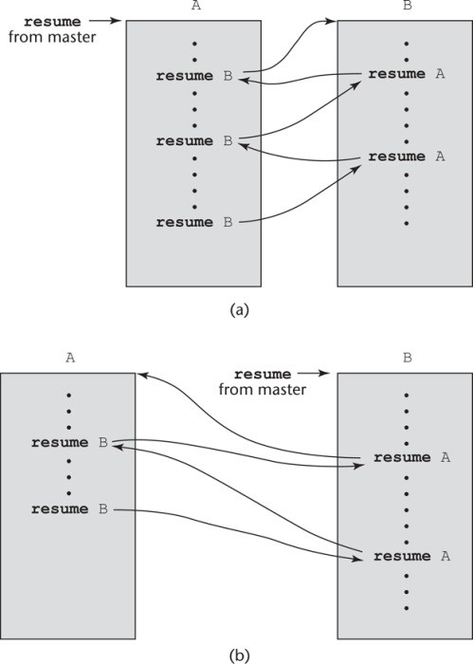
.
Two possible execution control sequences for two coroutines without loops

Slide 51
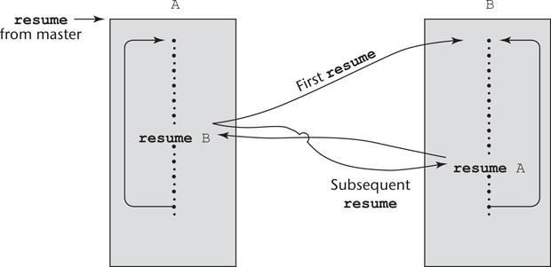
.
Coroutine execution sequence with loops

Slide 52
.
Implementing Subprograms
The simplest situation, nonnestable subprograms with static local variables, advance to more complicated subprograms with stack-dynamic local variables, and conclude with nested subprograms with stack-dynamic local variables and static scoping.
The increased difficulty of implementing subprograms in languages with nested subprograms is caused by the need to include mechanisms to access nonlocal variables.
  The General Semantics of Calls and Returns
The subprogram call and return operations are together called subprogram linkage.
The implementation of subprograms must be based on the semantics of the subprogram linkage of the language being implemented.

Slide 53
.
A subprogram call in a typical language has numerous actions associated with it. The call process must include the implementation of whatever - parameter-passing method is used.
If local variables are not static, the call process must allocate storage for the locals declared in the called subprogram and bind those variables to that storage. It must save the execution status of the calling program unit.
The execution status is everything needed to resume execution of the calling program unit.
The calling process also must arrange to transfer control to the code of the subprogram and ensure that control can return to the proper place when the subprogram execution is completed.

Slide 54
.
The required actions of a subprogram return are less complicated than those of a call.
If the subprogram has parameters that are out mode or inout mode and are implemented by copy, the first action of the return process is to move the local values of the associated formal parameters to the actual parameters.
Next, it must deallocate the storage used for local variables and restore the execution status of the calling program unit. Finally, control must be returned to the calling program unit.

Slide 55
.
  Implementing “Simple” Subprograms
We begin with the task of implementing simple subprograms. By “simple” we mean that subprograms cannot be nested and all local variables are static.
The semantics of a call to a “simple” subprogram requires the following actions:
1.Save the execution status of the current program unit.
2.Compute and pass the parameters.
3.Pass the return address to the called.
4.Transfer control to the called.
The semantics of a return from a simple subprogram requires the following actions:

Slide 56
.
1.If there are pass-by-value-result or out-mode parameters, the current values of those parameters are moved to or made available to the corresponding actual parameters.
2.If the subprogram is a function, the functional value is moved to a place accessible to the caller.
3.The execution status of the caller is restored.
4.Control is transferred back to the caller.
The call and return actions require storage for the following:
1. Status information about the caller Parameters
2. Return address
3. Return value for functions
4. Temporaries used by the code of the subprograms

Slide 57
.
In general, the linkage actions of the called can occur at two different times, either at the beginning of its execution or at the end.
These are sometimes called the prologue and epilogue of the subprogram linkage.
. In the case of a simple subprogram, all of the linkage actions of the callee occur at the end of its execution, so there is no need for a prologue.
A simple subprogram consists of two separate parts:
The actual code of the subprogram, which is constant.
The local variables and data listed previously, which can change when the subprogram is executed.
Both of these parts have fixed sizes.

Slide 58
.
The format, or layout, of the noncode part of a subprogram is called an activation record,
because the data it describes are relevant only during the activation or execution of the subprogram. The form of an activation record is static.
An activation record instance is a concrete example of an activation record, a collection of data in the form of an activation record.
Because languages with simple subprograms do not support recursion, there can be only one active version of a given subprogram at a time. Therefore, there can be only a single instance of the activation record for a subprogram.

Slide 59
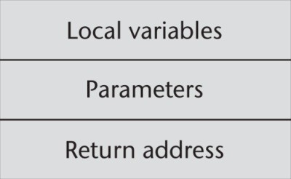
.
An activation record for simple subprogram
Because an activation record instance for a “simple” subprogram has fixed size, it can be statically allocated. In fact, it could be attached to the code part of the subprogram.

Slide 60
.
Since the activation record instance of simple sub program has fixed size, it can be statically allocated.
Actually it could be attached to the code part of program.
The code and activation of program with simple sub routine.
four program units—main,A,B,C
Main calls A,B, C
Originally all four program unit compiled different times individually.
When each program is compiled machine code, along with the list of reference to external sub rogram are write to file.

Slide 61
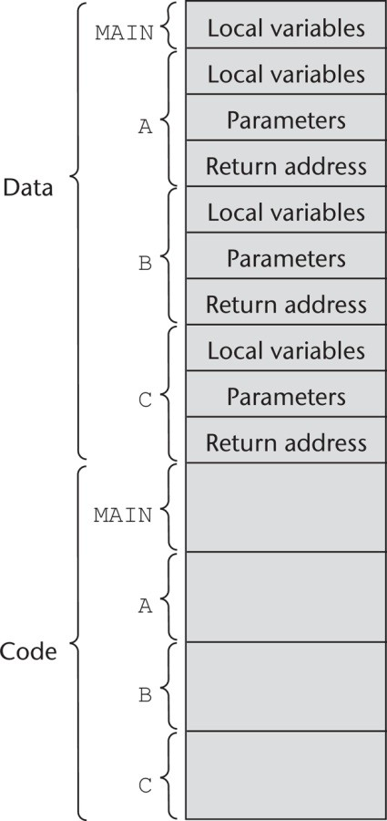
.
The code and - activation records of a program with simple subprograms

Slide 62
.
  Implementing Subprograms with Stack-Dynamic Local Variables
  One of the most important advantages of stack-dynamic local variables is support for recursion. Therefore, languages that use stack-dynamic local variables also support recursion.
  Subprogram linkage in languages that use stack-dynamic local variables are more complex than the linkage of simple subprograms for the following reasons:
The compiler must generate code to cause the implicit allocation and deallocation of local variables.
Recursion adds the possibility of multiple simultaneous activations of a subprogram, which means that there can be more than one instance (incomplete execution) of a subprogram at a given time, with at least one call from outside the subprogram and one or more recursive calls.

Slide 63
.
The number of activations is limited only by the memory size of the machine. Each activation requires its own activation record instance.
The format of an activation record for a given subprogram in most languages is known at compile time. In many cases, the size is also known for activation records because all local data are of a fixed size.
That is not the case in some other languages, such as Ada, in which the size of a local array can depend on the value of an actual parameter. In those cases, the format is static, but the size can be dynamic.In languages with stack-dynamic local variables, activation record instances must be created dynamically.
The dynamic link is a pointer to the base of the activation record instance of the caller. In static- scoped languages, this link is used to provide traceback information when a run-time error occurs. In dynamic-scoped languages, the dynamic link is used to access nonlocal variables.

Slide 64
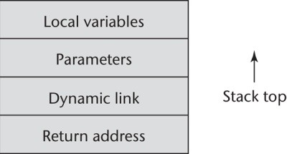
.
Consider the following skeletal C function:
void sub(float total, int part)
{
int list[5];
float sum;
. . .
}

Slide 65
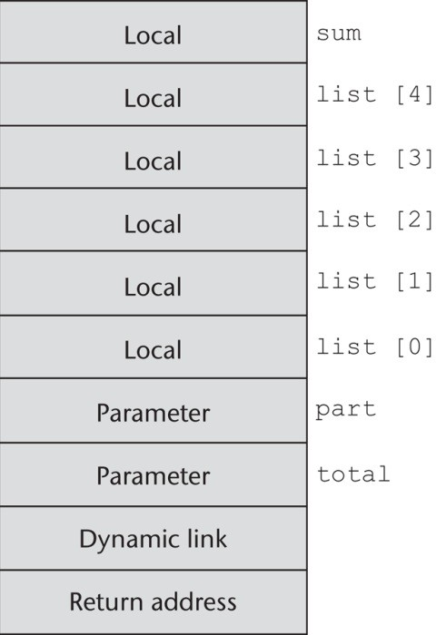
.

Slide 66
.
The caller actions are as follows:
Create an activation record instance.
Save the execution status of the current program unit.
Compute and pass the parameters.
Pass the return address to the called.
Transfer control to the called.
The prologue actions of the called are as follows:
Save the old EP in the stack as the dynamic link and create the new value.
Allocate local variables.
The epilogue actions of the called are as follows:
If there are pass-by-value-result or out-mode parameters, the current values of those parameters are moved to the corresponding actual parameters.
If the subprogram is a function, the functional value is moved to a place accessible to the caller.
Restore the stack pointer by setting it to the value of the current EP minus one and set the EP to the old dynamic link.
Restore the execution status of the caller.
Transfer control back to the caller.

Slide 67
.
    An Example without Recursion
Consider the following skeletal C program:
void fun1(float r) {
int s, t;
. . . < 1
fun2(s);
. . .
}
void fun2(int x) {
int y;
. . . < 2
fun3(y);
. .
}

Slide 68
.
void fun3(int q) {
. . . < 3
}
void main() {
float p;
. . .
fun1(p);
. . .
}
The sequence of function calls in this program is
main calls fun1
fun1 calls fun2
fun2 calls fun3

Slide 69
.
The collection of dynamic links present in the stack at a given time is called the dynamic chain, or call chain.
It represents the dynamic history of how execution got to its current position, which is always in the subprogram code whose activation record instance is on top of the stack
Recursion
Consider the following example C program, which uses recursion to compute the factorial function:
int factorial(int n) {
< 1
if (n <= 1)
return 1;
else return (n * factorial(n - 1));
< 2
}

Slide 70
.
void main() {
int value;
value = factorial(3);
< 3
}
  Implementing Nested Subprograms
All nonstatic variables that can be nonlocally accessed are in existing activation record instances and therefore are somewhere in the stack.
A reference to a nonlocal variable in a static-scoped language with nested subprograms requires a two-step access process.
The first step of the access process is to find the instance of the activation record in the stack in which the variable was allocated.

Slide 71
.
The second part is to use the local_offset of the variable (within the activation record instance) to access it.
    Static Chains
A static chain is a chain of static links that connect certain activation record instances in the stack.
Static link
The static link, which is sometimes called a static scope pointer, points to the bottom of the activation record instance of an activation of the static parent. It is used for accesses to nonlocal variables.
Static_depth
static_depth be an integer associated with a static scope that indicates how deeply it is nested in the outermost scope. A program unit that is not nested inside any other unit has a static_depth of 0.

Slide 72
.
nesting_depth, or chain_offset
It is difference between static depth and that of scope when it is declared.
A reference variable represented by chain _ffset,local_offset.
To illustrate the complete process of nonlocal accesses, consider the - following skeletal JavaScript program:
function main(){
var x;
function bigsub() { var a, b, c; function sub1 {
var a, d;
...
a = b + c; < 1
...
} // end of sub1

Slide 73
.
function sub2(x) {
var b, e;
function sub3() {
var c, e;
...
sub1();
...
e = b + a; < 2
} // end of sub3
...
sub3();
...
a = d + e; < 3
} // end of sub2
...
sub2(7);
...
} // end of bigsub

Slide 74
.
...
bigsub();
...
} // end of main
The sequence of procedure calls is
main calls bigsub
bigsub calls sub2
sub2 calls sub3
sub3 calls sub1

Slide 75
.
  Blocks
a number of languages, including the C-based languages, provide for user-specified local scopes for variables called blocks. As an example of a block, consider the following code segment:
{
int temp;
temp = list[upper]; l
ist[upper] = list[lower];
list[lower] = temp;
}
  A block is specified in the C-based languages as a compound statement that begins with one or more data definitions.
  The lifetime of the variable temp in the preceding block begins when control enters the block and ends when control exits the block.

Slide 76
.
The advantage of using such a local is that it cannot interfere with any other variable with the same name that is declared elsewhere in the program, or more specifically, in the referencing environment of the block.
Blocks can be implemented by using the static-chain process implementing nested subprograms.
Blocks are treated as parameterless subprograms that are always called from the same place in the program.
Therefore, every block has an activation record. An instance of its activation record is created every time the block is executed.
The maximum amount of storage required for block variables at any time during the execution of a program can be statically determined, because blocks are entered and exited in strictly textual order.

Slide 77
.
  Implementing Dynamic Scoping
There are at least two distinct ways in which local variables and nonlocal references to them can be implemented in a dynamic-scoped language:
1.deep access
2.shallow access
    Deep Access
Non local references found by searching the activation record instances of dynamic chain .
Length of chain can not be statically determined
Every activation record instance must have variable names

Slide 78
.
Consider the following example skeletal program:
void sub3() { int x, z; x = u + v;
. . .
}
void sub2() {
int w, x;
. . .
}
void sub1() {
int v, w;
. . .
}
void main() {
int v, u;
. . .
}

Slide 79
.
This program is written in a syntax that gives it the appearance of a program in a C-based language, but it is not meant to be in any particular language.
Suppose the following sequence of function calls occurs:
main calls sub1
sub1 calls sub1
sub1 calls sub2
sub2 calls sub3
Consider the references to the variables x, u, and v in function sub3. The reference to x is found in the activation record instance for sub3.
The reference to u is found by searching all of the activation record instances on the stack, because the only existing variable with that name is in main.
This search involves following four dynamic links and examining 10 variable names. The reference to v is found in the most recent (nearest on the dynamic chain) activation record instance for the subprogram sub1.

Slide 80
.
    Shallow Access
    In the shallow-access method, variables declared in subprograms are not stored in the activation records of those subprograms.
    One variation of shallow access is to have a separate stack for each variable name in a complete program.
    Every time a new variable with a particular name is created by a declaration at the beginning of a subprogram that has been called, the variable is given a cell at the top of the stack for its name.
    Every reference to the name is to the variable on top of the stack associated with that name, because the top one is the most recently created.

Slide 81
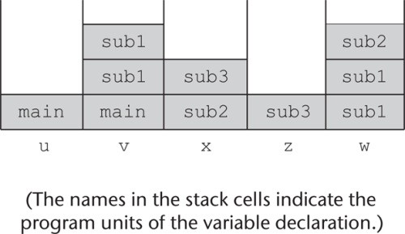
.
Eg is taken same deep access
One variation is to have a “hidden” stack on which all saved objects are stored. Because subprogram calls and returns, and thus the lifetimes of local variables, are nested, this works well.
The second variation is perhaps the cleanest and least expensive to implement.
The choice between shallow and deep access to nonlocal variables depends on the relative frequencies of subprogram calls and nonlocal references

Slide 82
.
Abstract Data Types and Encapsulation Constructs
Concept of Abstract Data Types(ADT):
An abstraction is a view or representation of an entity that includes only the most significant attributes.
In the world of programming languages, abstraction is a weapon against the complexity of programming; its purpose is to simplify the programming process.
It is an effective weapon because it allows programmers to focus on essential attributes, while ignoring subordinate attributes.

Slide 83
.
Process abstraction:
All subprograms are process abstraction because they provide way for a program to specify the process without providing the details of how its perform tasks.
For example, when a program needs to sort an array of numeric data of some type, it usually uses a subprogram for the sorting process. At the point where the sorting process is required, a statement such as
sortInt(list, listLen)
is placed in the program. This call is an abstraction of the actual sorting process, whose algorithm is not specified. The call is independent of the algorithm implemented in the called subprogram.

Slide 84
.
Abstract data type:
It also called as information hiding. It is also allows user to create data object(variable) of abstract data type and also allows user to perform some operations on these objects but implementation of these types hidden from the user .
Program units that use an abstract data type can declare variables of that type, even though the actual representation is hidden from them. An instance of an abstract data type is called an object.
    Floating-Point as an Abstract Data Type
A floating-point type provides the means to create variables to store floating-point data and also provides a set of arithmetic operations for manipulating objects of the type.

Slide 85
.
Floating-point types in high-level languages employ a key concept in data abstraction: information hiding.
The actual format of the floating-point data value in a memory cell is hidden from the user, and the only operations available are those provided by the language.
The user is not allowed to create new operations on data of the type, except those that can be constructed using the built-in operations.
The user cannot directly manipulate the parts of the actual representation of values because that representation is hidden. It is this feature that allows program portability between implementations of a particular language, even though the implementations may use different representations for particular data types.

Slide 86
.
    User-Defined Abstract Data Types
A user-defined abstract data type should provide the same characteristics as those of language-defined types, such as a floating-point type:
(1) a type definition that allows program units to declare variables of the type but hides the representation of objects of the type; and
(2) a set of operations for manipulating objects of the type.
We now formally define an abstract data type in the context of user-defined types. An abstract data type is a data type that satisfies the following

Slide 87
.
The representation of objects of the type is hidden from the program units that use the type, so the only direct operations possible on those objects are those provided in the type’s definition.
The declarations of the type and the protocols of the operations on objects of the type, which provide the type’s interface, are contained in a single syntactic unit. The type’s interface does not depend on the representation of the objects or the implementation of the operations.
Also, other program units are allowed to create variables of the defined type.

Slide 88
.
Advantages :
Increase reliability .Program units that use a specific abstract data type are called clients of that type.
it reduces the range of code and number of variables of which a programmer must be aware when writing or reading a part of the program.
Information hiding also makes name conflicts less likely, because the scopes of variables is smaller.
Encapsulation
Abstraction
Data Structure Independence
Information Hiding
Modularity

Slide 89
.
  Design Issues for Abstract Data Types
The first design issue is whether abstract data types can be parameterized.
The second design issue is what access controls are provided and how such controls are specified.
Finally, the language designer must decide whether the specification of the type is physically separate from its implementation (or whether that is a developer choice).
The form of the container for the interface to the type.

Slide 90
.
  Language Examples
we describe the support for data abstraction provided by C++, Java, C#, and Ruby.
      Abstract Data Types in C++
      C++, which was first released in 1985, was created by adding features to C. The first important additions were those to support object-oriented programming. Because one of the primary components of object-oriented programming is abstract data types.
      Encapsulation: The data defined in a C++ class are called data members; the functions (methods) defined in a class are called member functions.
      Data members and member functions appear in two categories: class and instance.

Slide 91
.
      Information Hiding : A C++ class can contain both hidden and visible entities (meaning they are either hidden from or visible to clients of the class).
      Entities that are to be hidden are placed in a private clause, and visible, or public, entities appear in a public clause. The public clause therefore describes the interface to class instances.
There is also a third category of visibility, protected, which makes a member visible to subclasses, but not to clients.
      Constructors and Destructors : C++ allows the user to include constructor functions in class definitions, which are used to initialize the data members of newly created objects. A constructor may also allocate the heap-dynamic data that are referenced by the pointer members of the new object.

Slide 92
.
A C++ class can also include a function called a destructor, which is implicitly called when the lifetime of an instance of the class ends. As stated earlier, stack-dynamic class instances can contain pointer members that reference heap-dynamic data.
      An Example
Our example of a C++ abstract data type is a stack:
#include <iostream.h>
class Stack {
private: //** These members are visible only to other
//** members and friends (see Section 11.6.4)
int *stackPtr;
int maxLen;
int topSub;

Slide 93
.
public: //** These members are visible to clients Stack() { //** A constructor
stackPtr = new int [100]; maxLen = 99;
topSub = -1;
}
~Stack() {delete [] stackPtr;}; //** A destructor
void push(int number) {
if (topSub == maxLen)
cerr << "Error in push--stack is full\n";
else stackPtr[++topSub] = number;
}
void pop() {
if (empty())
cerr << "Error in pop--stack is empty\n";
else topSub--;
}
int top() {
if (empty())
cerr << "Error in top--stack is empty\n";
else
return (stackPtr[topSub]);
}
int empty() {return (topSub == -1);}
}

Slide 94
.
  Encapsulation Constructs
When the size of a program reaches beyond a few thousand lines, two practical problems become evident. From the programmer’s point of view, having such a program appear as a single collection of subprograms or abstract data type definitions does not impose an adequate level of organization on the program to keep it intellectually manageable.
The second practical problem for larger programs is recompilation. For relatively small programs, recompiling the whole program after each modification is not costly. But for large programs, the cost of recompilation is significant. So, there is an obvious need to find ways to avoid recompilation of the parts of a program that are not affected by a change.

Slide 95
.
The obvious solution to both of these problems is to organize programs into collections of logically related code and data, each of which can be compiled without recompilation of the rest of the program. An encapsulation is such a collection.
In languages that allow nested subprograms, programs can be organized by nesting subprogram definitions inside the logically larger subprograms that use them. This can be done in Python and Ruby.
    Encapsulation in C
C does not provide complete support for abstract data types, although both abstract data types and multiple-type encapsulations can be simulated.
In C, a collection of related functions and data definitions can be placed in a file, which can be independently compiled.

Slide 96
.
Such a file, which acts as a library, has an implementation of its entities
The interface to such a file, including data, type, and function declarations, is placed in a separate file called a header file.
Type representations can be hidden by declaring them in the header file as pointers to struct types. The complete definitions of such struct types need only appear in the implementation file.
When such a library is used, the header file is included in the client code, using an #include preprocessor specification, so that references to functions and data in the client code can be type checked.
The #include specification also documents the fact that the client program depends on the library implementation file. This approach effectively separates the specification and implementation of an encapsulation.

Slide 97
.
    Encapsulation in C++
C++ provides two different kinds of encapsulation: header and implementation files can be defined as in C, or class headers and definitions can be defined.
Because of the complex interplay of C++ templates and separate compilation, the header files of C++ template libraries often include complete definitions of resources, rather than just data declarations and subprogram protocols; this is due in part to the use of the C linker for C++ programs.
One language design problem that results from having classes but no generalized encapsulation construct is that sometimes when operations are defined that use two different classes of objects, the operation does not naturally belong in either class.

Slide 98
.
For example, suppose we have an abstract data type for matrices and one for vectors and need a multiplication operation between a vector and a matrix. The multiplication code must have access to the data members of both the vector and the matrix classes, but neither of those classes is the natural home for the code.
The following skeletal code illustrates this scenario:
class Matrix; //** A class declaration
class Vector {
friend Vector multiply(const Matrix&, const Vector&);
. . .
};
class Matrix { //** The class definition
friend Vector multiply(const Matrix&, const Vector&);
. . .
};
//** The function that uses both Matrix and Vector objects Vector multiply(const Matrix& m1, const Vector& v1) {
. . .
}

Slide 99
.
    C# Assemblies
C# includes a larger encapsulation construct than a class. The construct is the one used by all of the .NET programming languages: the assembly.
Assemblies are built by .NET compilers. A .NET application consists of one or more assemblies
. An assembly is a file that appears to application programs to be a single dynamic link library (.dll) or an executable (.exe). An assembly defines a module, which can be separately developed
In
.NET, the intermediate language is named Common Intermediate Language (CIL). It is used by all .NET languages. Because its code is in CIL, an assembly can be used on any architecture, device, or operating system

Slide 100
.
A dynamic link library (DLL) is a collection of classes and methods that are individually linked to an executing program when needed during execution. Therefore, although a program has access to all of the resources in a particular DLL, only the parts that are actually used are ever loaded and linked to the program
DLLs have been part of the Windows programming environment since Windows first appeared. However, the DLLs of .NET are quite different from those of previous Windows systems
In addition to the CIL code, a .NET assembly includes metadata that describes every class it defines, as well as all external classes it uses. An assembly also includes a list of all assemblies referenced in the assembly and an assembly version number.

Slide 101
.
In the .NET world, the assembly is the basic unit of deployment of software. Assemblies can be private, in which case they are available to just one application, or public, which means any application can use them.
As mentioned previously, C# has an access modifier, internal. An internal member of a class is visible to all classes in the assembly in which it appears.
Java has a file structure that is similar to an assembly called a Java Archive (JAR). It is also used for deployment of Java software systems. JARs are built with the Java utility jar, rather than a compiler.

Slide 102
.
  Naming Encapsulations
We have considered encapsulations to be syntactic containers for logically related software resources—in particular, abstract data types. The purpose of these encapsulations is to provide a way to organize programs into logical units for compilation.
This allows parts of programs to be recompiled after isolated changes. There is another kind of encapsulation that is necessary for constructing large programs: a naming encapsulation
A large program is usually written by many developers, working somewhat independently, perhaps even in different geographic locations. This requires the logical units of the program to be independent, while still able to work together

Slide 103
.
Libraries are the origin of the same kind of naming problems. Over the past two decades, large software systems have become progressively more dependent on libraries of supporting software
Nearly all software written in contemporary programming languages requires the use of large and complex standard libraries, in addition to application-specific libraries. This widespread use of multiple libraries has necessitated new mechanisms for managing names
For example, when a developer adds new names to an existing library or creates a new library, he or she must not use a new name that conflicts with a name already defined in a client’s application program or in some other library the program uses

Slide 104
.
Naming encapsulations define name scopes that assist in avoiding these name conflicts. Each library can create its own naming encapsulation to prevent its names from conflicting with the names defined in other libraries or in client code. Each logical part of a software system can create a naming encapsulation with the same purpose.
Naming encapsulations are logical encapsulations, in the sense that they need not be physically contiguous. Several different collections of code can be placed in the same namespace, even though they are stored in different places. In the following sections, we briefly describe the uses of naming encapsulations in C++, Java, and Ruby.

Slide 105
.
    C++ Namespaces
C++ includes a specification, namespace, that helps programs manage the problem of global namespaces. One can place each library in its own namespace and qualify the names in the program with the name of the namespace when the names are used outside that namespace.
For example, suppose there is an abstract data type header file that implements stacks. If there is concern that some other library file may define a name that is used in the stack abstract data type, the file that defines the stack could be placed in its own namespace.
This is done by placing all of the declarations for the stack in a namespace block, as in the following:
namespace myStackSpace {
// Stack declarations
}

Slide 106
.
    Java Packages
Java includes a naming encapsulation construct: the package. Packages can contain more than one type definition, and the types in a package are partial friends of one another. Partial here means that the entities defined in a type in a package that either are public or protected or have no access specifier are visible to all other types in the package.
By type here we mean either a class or an interface.
Entities without access modifiers are said to have package scope, because they are visible throughout the package. Java therefore has less need for explicit friend declarations and does not include the friend functions or friend classes of C++.
The resources defined in a file are specified to be in a particular package with a package declaration, as in
package stkpkg;

Slide 107
.
The package declaration must appear as the first line of the file. The resources of every file that does not include a package declaration are implicitly placed in the same unnamed package.
The clients of a package can reference the types defined in the package using fully qualified names. For example, if the package stkpkg has a class named myStack, that class can be referenced in a client of stkpkg as stkpkg.myStack. Likewise, a variable in the myStack object named topSub could be referenced as stkpkg.myStack.topSub. Because this approach can quickly become cumbersome when packages are nested, Java provides the import declaration, which allows shorter references to type names defined in a package. For example, suppose the client includes the following:
import stkpkg.myStack;
Now, the class myStack can be referenced by just its name. To be able to access all of the type names in the package, an asterisk can be used on the import statement in place of the type name. For example, if we wanted to import all of the types in stkpkg, we could use the following:
import stkpkg.*;

Slide 108
.
    Ruby Modules
Ruby classes serve as namespace encapsulations, as do the classes of other languages that support object-oriented programming. Ruby has an additional naming encapsulation, called a module.
Modules typically define collections of methods and constants. So, modules are convenient for encapsulating libraries of related methods and constants, whose names are in a separate namespace so there are no name conflicts with other names in a program that uses the module.
Modules are unlike classes in that they cannot be instantiated or subclassed and do not define variables
Methods that are defined in a module include the module’s name in their names. For example, consider the following skeletal module definition:

Slide 109
.
module MyStuff PI = 3.14159265
def MyStuff.mymethod1(p1)
. . .
end
def MyStuff.mymethod2(p2)
. . .
end end
Assuming the MyStuff module is stored in its own file, a program that wants to use the constant and methods of MyStuff must first gain access to the module. This is done with the require method, which takes the file name in the form of a string literal as a parameter. Then, the constants and methods of the module can be accessed through the module’s name

Slide 110
.
Consider the following code that uses our example module, MyStuff, which is stored in the file named myStuffMod:
require 'myStuffMod'
. . .
MyStuff.mymethod1(x)
. . .

